Slide 1
ROS编程基础
ROS 编程的准备工作
创建和运行订阅器和发布器节点
创建并运行服务端和客户端节点
创建并运行动作服务器和客户端节点
如何使用参数
如何使用roslaunch

Slide 2

ROS 编程的准备工作
Quantity | Unit
angle | radian
frequency | hertz
force | newton
power | watt
voltage | volt
Quantity | Unit
length | meter
mass | kilogram
time | second
current | ampere
temperature | celsius
标准单位
SI unit
国际单位制
坐标表示
x: 前, y: 坐, z: 上
右手定则
编程规则
Object | Naming rule | example
Package | under_scored | Ex) first_ros_package
Topic, service | under_scored | Ex) raw_image
File | under_scored | Ex) turtlebot3_fake.cpp
Namespace | under_scored | Ex) ros_awesome_package
Variable | under_scored | Ex) string table_name;
type | CamelCased | Ex) typedef int32_t PropertiesNumber;
Class | CamelCased | Ex) class UrlTable
Structure | CamelCased | Ex) struct UrlTableProperties
Enumeration type | CamelCased | Ex) enum ChoiceNumber
Function | camelCased | Ex) addTableEntry();
Method | camelCased | Ex) void setNumEntries(int32_t num_entries)
Constant | ALL_CAPITALS | Ex) const uint8_t DAYS_IN_A_WEEK = 7;
Macro | ALL_CAPITALS | Ex) #define PI_ROUNDED 3.0

Slide 3
ROS 消息通讯类型
消息通讯类型
(Topics, Services, Actions, Parameters)
节点1
节点2
话题
Publisher
Subscriber
服务端请求
Service server
Service client
服务端响应
Action server
传递行动目标
Action client
传递行动反馈
传递行动结果
parameter
Parameter server
(ROS Master)
parameter
write
read

Slide 4
话题
节点1
节点2
发布
Topic
订阅

Slide 5
服务
节点1
节点2
Service 请求
服务 server
服务 client
Service响应

Slide 6
Action
节点1
节点2
传递 action 目标
Action server
传递 action 反馈
Action client
传递 action 结果

Slide 7
参数
节点1
节点2
parameter
Parameter server
(ROS Master)
parameter
write
read

Slide 8
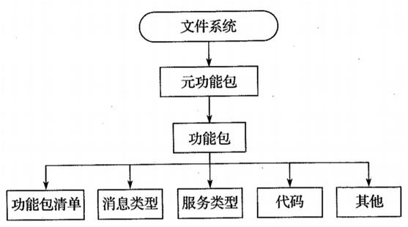
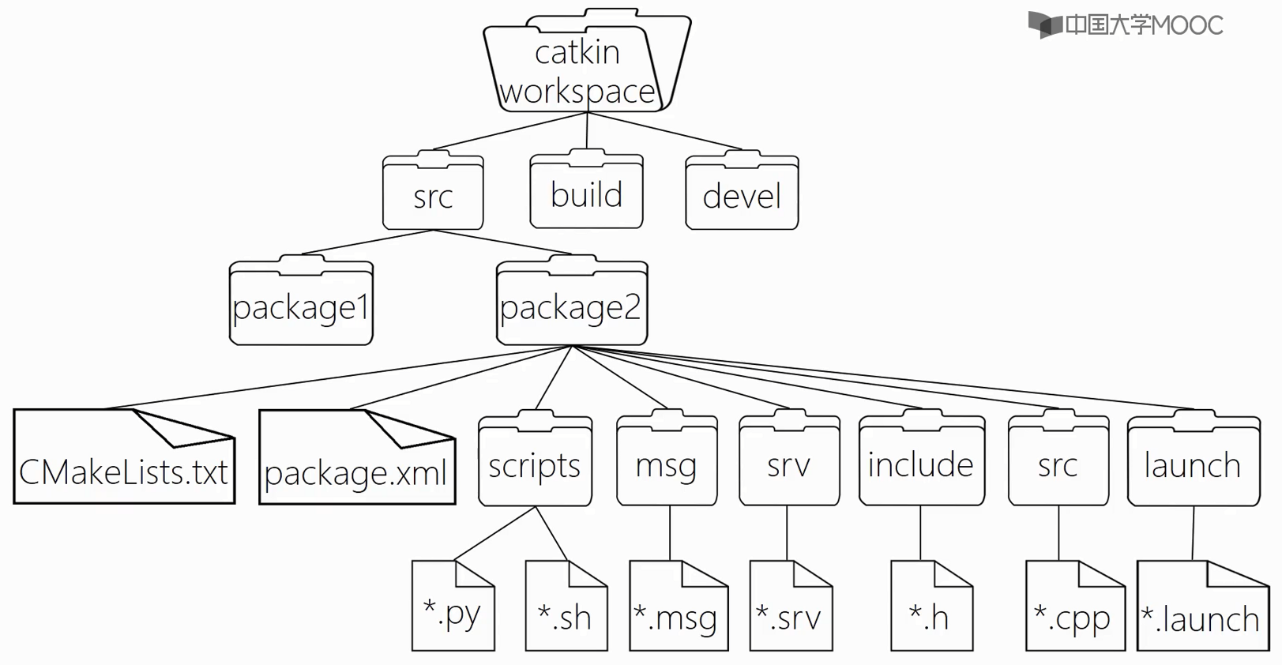
Ros系统项目结构

Slide 9
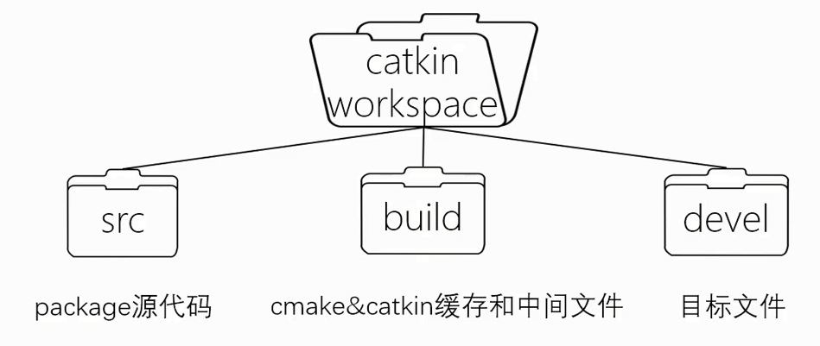
Ros系统项目结构

Slide 10
现在让我们开始写代码
Topic: 发布, 订阅
服务: 服务 server, 服务client

Slide 11
Topic
节点1
节点2
Publisher
Topic
Subscriber

Slide 12
Topic / Publisher / Subscriber
ROS使用“主题”消息通信进行单向通信。 在本教程中，发送者称为“发布者”，接收者称为“订阅者”。
1) 创建ROS包
$ cd ~/catkin_ws/src
$ catkin_create_pkg ros_tutorials_topic message_generation std_msgs roscpp
$ cd ros_tutorials_topic
$ ls
include → header file folder
src → source code folder
CMakeLists.txt → build configuration file
package.xml → package configuration file

Slide 13
Topic / Publisher / Subscriber
2)修改软件包配置文件(package.xml)
所需的ROS配置文件之一package.xml是一个XML文件，其中包含描述软件包名称，作者，许可证和依赖软件包的软件包信息。
$ gedit package.xml
<?xml version="1.0"?>
<package>
<name>ros_tutorials_topic</name>
<version>0.1.0</version>
<description>ROS turtorial package to learn the topic</description>
<license>Apache License 2.0</license>
<author email="pyo@robotis.com">Yoonseok Pyo</author>
<maintainer email="pyo@robotis.com">Yoonseok Pyo</maintainer>
<url type="bugtracker">https://github.com/ROBOTIS-GIT/ros_tutorials/issues</url>
<url type="repository">https://github.com/ROBOTIS-GIT/ros_tutorials.git</url>
<url type="website">http://www.robotis.com</url>

Slide 14
Topic / Publisher / Subscriber
<buildtool_depend>catkin</buildtool_depend>
<build_depend>roscpp</build_depend>
<build_depend>std_msgs</build_depend>
<build_depend>message_generation</build_depend>
<run_depend>roscpp</run_depend>
<run_depend>std_msgs</run_depend>
<run_depend>message_runtime</run_depend>
<export></export>
</package>

Slide 15
Topic / Publisher / Subscriber
3)修改生成配置文件(CMakeLists.txt)
$ gedit CMakeLists.txt
cmake_minimum_required(VERSION 2.8.3)
project(ros_tutorials_topic)
## This is the component package required for catkin build.
## dependency packages are message_generation, std_msgs, and roscpp. If these packages do not exist, an error occurs when you build.
find_package(catkin REQUIRED COMPONENTS message_generation std_msgs roscpp)
## Message declaration: MsgTutorial.msg
add_message_files(FILES MsgTutorial.msg)
## This is an option to configure dependent messages.
## If std_msgs is not installed, an error occurs when you build.
generate_messages(DEPENDENCIES std_msgs)
## The catkin_package option describes the library, catkin build dependencies, and system dependent packages.
catkin_package(
LIBRARIES ros_tutorials_topic
CATKIN_DEPENDS std_msgs roscpp
)

Slide 16
Topic / Publisher / Subscriber
## Set the include directory.
include_directories(${catkin_INCLUDE_DIRS})
## Build option for the topic_publisher node.
## Configure the executable file, target link library, and additional dependencies. add_executable(topic_publisher src/topic_publisher.cpp)
add_dependencies(topic_publisher ${${PROJECT_NAME}_EXPORTED_TARGETS} ${catkin_EXPORTED_TARGETS})
target_link_libraries(topic_publisher ${catkin_LIBRARIES})
## Build option for the topic_subscriber node.
add_executable(topic_subscriber src/topic_subscriber.cpp)
add_dependencies(topic_subscriber ${${PROJECT_NAME}_EXPORTED_TARGETS} ${catkin_EXPORTED_TARGETS})
target_link_libraries(topic_subscriber ${catkin_LIBRARIES})

Slide 17
Topic / Publisher / Subscriber
4) 创建消息文件
在CMakeLists.txt文件中添加以下选项.
此命令表示在构建消息时应基于MsgTutorial.msg来构建消息.
Time (消息格式), stamp (消息名称)
int32 (消息类型), data (消息名称)
除时间和int32之外，消息类型还包括消息基本类型，例如bool，int8，int16，float32，字符串，时间，持续时间和common_msgs，它们收集ROS中使用的消息。 在这里，我们使用time和int32创建一个简单的示例。 （请参阅附录C和http://wiki.ros.org/msg）
add_message_files(FILES MsgTutorial.msg)
$ roscd ros_tutorials_topic → Move to package folder
$ mkdir msg → Create a message folder named msg in the package
$ cd msg → Move to the msg folder you created
$ gedit MsgTutorial.msg → Create new MsgTutorial.msg file and modify contents
time stamp
int32 data

Slide 18
Topic / Publisher / Subscriber
5) 创建发布节点
添加选项以在CMakeLists.txt文件中生成以下可执行文件.
在src文件夹中构建一个名为topic_publisher.cpp的文件，以创建一个名为topic_publisher的可执行文件。
add_executable(topic_publisher src/topic_publisher.cpp)
$ roscd ros_tutorials_topic/src → Move to the src folder, which is the source folder of the package
$ gedit topic_publisher.cpp → New source file and modify contents
#include "ros/ros.h" // ROS basic header file
#include "ros_tutorials_topic/MsgTutorial.h" // MsgTutorial message file header(Auto-generated after build)
int main(int argc, char **argv) // Node main function
{
ros::init(argc, argv, "topic_publisher"); // Node name initialization
ros::NodeHandle nh; // Node handle declaration for communication with ROS system

Slide 19
Topic / Publisher / Subscriber
// Publisher declaration, using MsgTutorial message file from ros_tutorials_topic package
// Create the publisher ros_tutorial_pub. The topic name is "ros_tutorial_msg"
// set the publisher queue size to 100
ros::Publisher ros_tutorial_pub = nh.advertise<ros_tutorials_topic::MsgTutorial>("ros_tutorial_msg", 100);
// Set the loop period. & Quot; 10 & quot; refers to 10 Hz and repeats at 0.1 second intervals
ros::Rate loop_rate(10);
// Declare msg message in MsgTutorial message file format
ros_tutorials_topic::MsgTutorial msg;
// Declare variable to be used in message
int count = 0;

Slide 20
Topic / Publisher / Subscriber
while (ros::ok())
{
msg.stamp = ros::Time::now(); // Put the current time in the msg's substamp message
msg.data = count; // Put the value of the variable count in the lower data message of msg
ROS_INFO("send msg = %d", msg.stamp.sec); // Display the stamp.sec message
ROS_INFO("send msg = %d", msg.stamp.nsec); // Display the stamp.nsec message
ROS_INFO("send msg = %d", msg.data); // Display data message
ros_tutorial_pub.publish(msg); // Publish message
loop_rate.sleep(); // Go to sleep according to the loop cycle defined above
++count; // Increment count variable by 1
}
return 0;
}

Slide 21
Topic / Publisher / Subscriber
6) 创建订阅节点
在CMakeLists.txt文件中，添加选项以生成以下可执行文件。
也就是说，构建一个名为topic_subscriber.cpp的文件以创建一个名为topic_subscriber的可执行文件。
add_executable(topic_subscriber src/topic_subscriber.cpp)
$ roscd ros_tutorials_topic/src → Move to the src folder, which is the source folder of the package
$ gedit topic_subscriber.cpp → New source file and modify contents
#include "ros/ros.h" // ROS basic header file
#include "ros_tutorials_topic/MsgTutorial.h" // MsgTutorial message file header (Auto-generated after build)
// A message callback function, named ros_tutorial_msg below
// This is a function that works when a message is received
// The input message is supposed to receive the MsgTutorial message from the ros_tutorials_topic package
void msgCallback(const ros_tutorials_topic::MsgTutorial::ConstPtr& msg)
{
ROS_INFO("recieve msg = %d", msg->stamp.sec); // Disaplay stamp.sec message
ROS_INFO("recieve msg = %d", msg->stamp.nsec); // Disaplay stamp.nsec message
ROS_INFO("recieve msg = %d", msg->data); // Disaplay data message
}

Slide 22
Topic / Publisher / Subscriber
int main(int argc, char **argv) // Node main function
{
ros::init(argc, argv, "topic_subscriber"); // Initialize the node name
ros::NodeHandle nh; // Declare a node handle to communicate with the ROS system
// Subscriber declaration, using MsgTutorial message file from ros_tutorials_topic package
// Create subscriber ros_tutorial_sub. The topic name is "ros_tutorial_msg"
// Set the subscriber queue size to 100
ros::Subscriber ros_tutorial_sub = nh.subscribe("ros_tutorial_msg", 100, msgCallback);
// callback function will be waiting for message to be received,
// Execute callback function when message is received
ros::spin();
return 0;
}

Slide 23
Topic / Publisher / Subscriber
7) 构建ROS 节点
使用以下命令在ros_tutorials_topic包中构建消息文件，发布者节点和订阅者节点：
[参考] 文件系统
ros_tutorials_topic包的源代码文件： ~/catkin_ws/src/ros_tutorials_topic/src
ros_tutorials_topic包的消息文件: ~/catkin_ws/src/ros_tutorials_topic/msg
生成的文件位于/ catkin_ws的/ build和/ devel文件夹中
/build文件夹保存在catkin构建中使用的设置
/devel/lib/ros_tutorials_topic 文件夹保存着可执行文件
/devel/include/ros_tutorials_topic文件夹保存从邮件文件自动生成的邮件头文件
$ cd ~/catkin_ws → Move to catkin folder
$ catkin_make → Execute catkin build

Slide 24
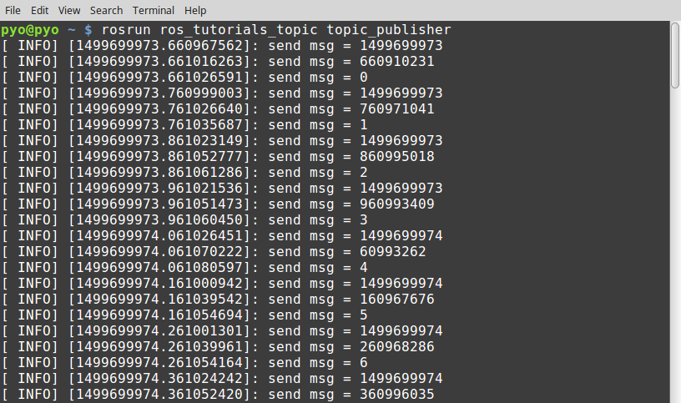
Topic / Publisher / Subscriber
8) 执行发布
下面的命令运行ros_tutorials_topic包中的topic_publisher节点
[注意: 不要忘记在运行节点之前先运行roscore.]
$ rosrun ros_tutorials_topic topic_publisher

Slide 25
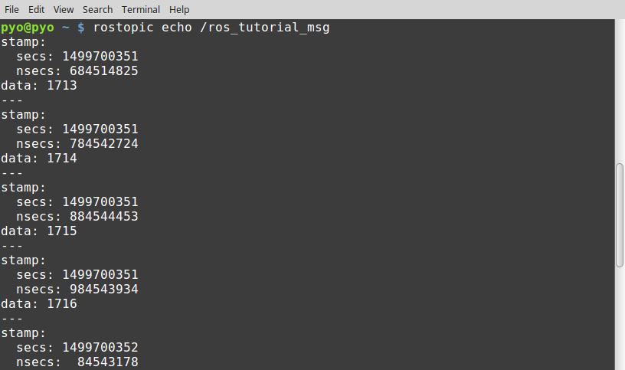
Topic / Publisher / Subscriber
[参考] rostopic
您可以使用rostopic命令检查主题列表，周期，数据带宽和当前ROS网络的内容。
$ rostopic list
/ros_tutorial_msg
/rosout
/rosout_agg
$ rostopic echo /ros_tutorial_msg

Slide 26
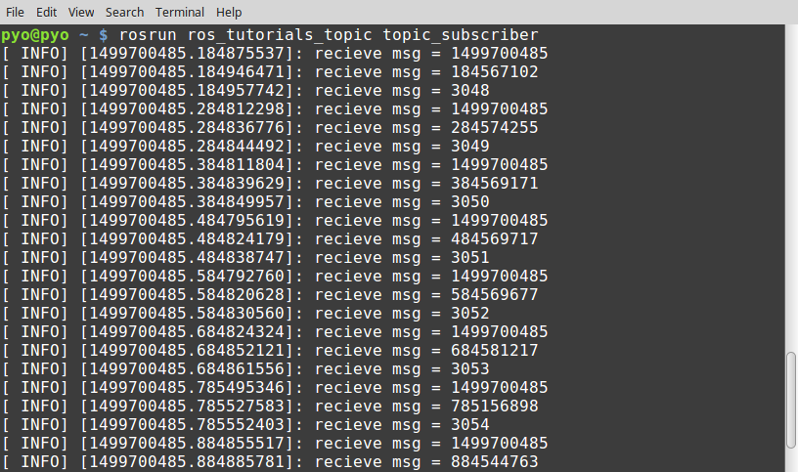
Topic / Publisher / Subscriber
9) 执行订阅
下面的命令运行ros_tutorials_topic包的topic_subscriber节点。
$ rosrun ros_tutorials_topic topic_subscriber

Slide 27
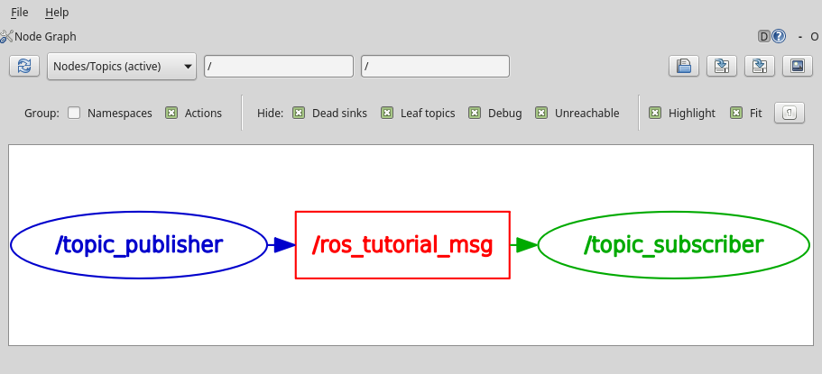
Topic / Publisher / Subscriber
10)在执行节点之前检查通信状态
$ rqt_graph
$ rqt [Plugins] → [Introspection] → [Node Graph]

Slide 28
源代码
我们创建了使用主题的发布者和订阅者节点，并执行它们以了解如何在节点之间进行通信。 相关资源可以在下面的github地址找到。
https://github.com/ROBOTIS-GIT/ros_tutorials/tree/master/ros_tutorials_topic
如果您想立即应用它，则可以使用以下命令在catkin_ws / src文件夹中克隆源代码并进行构建。 然后运行topic_publisher和topic_subscriber节点。
$ cd ~/catkin_ws/src
$ git clone https://github.com/ROBOTIS-GIT/ros_tutorials.git
$ cd ~/catkin_ws
$ catkin_make
$ rosrun ros_tutorials_topic topic_publisher
$ rosrun ros_tutorials_topic topic_subscriber

Slide 29
Service
节点1
节点2
Service 请求
Service server
Service client
Service 响应

Slide 30
Service / Service 服务端 / Service c客户端
服务分为仅在有请求时才响应的服务服务器和请求并作出响应的服务客户端。 与主题不同，该服务是一次性消息通信。 因此，当服务的请求和响应完成时，两个连接的节点将断开连接。
当机器人应执行特定操作或节点应根据特定条件生成事件时，通常将此服务用作指令。 另外，由于它是一种一次性通信方法，因此它非常有用，因为网络负载较小，因此可以代替主题。
在本讲中，其目的是创建一个简单的服务文件以及创建和执行服务服务器节点和服务客户端节点。

Slide 31
Service / Service server / Service client
需要双向（或同步）通信时，ROS使用称为“服务”的消息通信。
Service服务器”仅在有请求和“服务客户端”请求时才响应并做出响应。
1) 创建包
$ cd ~/catkin_ws/src
$ catkin_create_pkg ros_tutorials_service message_generation std_msgs roscpp
$ cd ros_tutorials_service
$ ls
include → header file folder
src → source code folder
CMakeLists.txt → build configuration file
package.xml → package configuration file

Slide 32
Service / Service server / Service client
2)修改软件包配置文件(package.xml)
所需的ROS配置文件之一package.xml是一个XML文件，其中包含软件包信息，该信息描述了软件包名称，作者，许可证和依赖软件包。
$ gedit package.xml
<?xml version="1.0"?>
<package>
<name>ros_tutorials_service</name>
<version>0.1.0</version>
<description>ROS turtorial package to learn the service</description>
<license>Apache License 2.0</license>
<author email="pyo@robotis.com">Yoonseok Pyo</author>
<maintainer email="pyo@robotis.com">Yoonseok Pyo</maintainer>
<url type="bugtracker">https://github.com/ROBOTIS-GIT/ros_tutorials/issues</url>
<url type="repository">https://github.com/ROBOTIS-GIT/ros_tutorials.git</url>
<url type="website">http://www.robotis.com</url>

Slide 33
Service / Service server / Service client
<buildtool_depend>catkin</buildtool_depend>
<build_depend>roscpp</build_depend>
<build_depend>std_msgs</build_depend>
<build_depend>message_generation</build_depend>
<run_depend>roscpp</run_depend>
<run_depend>std_msgs</run_depend>
<run_depend>message_runtime</run_depend>
<export></export>
</package>

Slide 34
Service / Service server / Service client
3)修改构建配置文件(CMakeLists.txt)
$ gedit CMakeLists.txt
cmake_minimum_required(VERSION 2.8.3)
project(ros_tutorials_service)
## This is the component package required for catkin build
## dependency packages are message_generation, std_msgs, and roscpp. If these packages do not exist, an error occurs when you build.
find_package(catkin REQUIRED COMPONENTS message_generation std_msgs roscpp)
## Service declaration: SrvTutorial.srv
add_service_files(FILES SrvTutorial.srv)
## This is an option to configure dependent messages.
## If std_msgs is not installed, an error occurs when you build.
generate_messages(DEPENDENCIES std_msgs)
## The catkin package option describes the library, catkin build dependencies, and system dependent packages.
catkin_package(
LIBRARIES ros_tutorials_service
CATKIN_DEPENDS std_msgs roscpp
)

Slide 35
Service / Service server / Service client
## Set the include directory.
include_directories(${catkin_INCLUDE_DIRS})
## Build option for the service_server node.
## Configure the executable file, target link library, and additional dependencies. add_executable(service_server src/service_server.cpp)
add_dependencies(service_server ${${PROJECT_NAME}_EXPORTED_TARGETS} ${catkin_EXPORTED_TARGETS})
target_link_libraries(service_server ${catkin_LIBRARIES})
## Build option for the service_client node.
add_executable(service_client src/service_client.cpp)
add_dependencies(service_client ${${PROJECT_NAME}_EXPORTED_TARGETS} ${catkin_EXPORTED_TARGETS})
target_link_libraries(service_client ${catkin_LIBRARIES})

Slide 36
Service / Service server / Service client
4) 编写服务文件
将下列选项添加到CMakeLists.txt .
此命令表示应基于SrvTutorial.srv构建服务
int64 (message format), a, b (request for service), result (service response: response), '---‘(delimiter of request and response)
add_service_files(FILES SrvTutorial.srv)
$ roscd ros_tutorials_service → Move to package folder
$ mkdir srv → Create a new service folder named srv in the package
$ cd srv → Go to the created srv folder
$ gedit SrvTutorial.srv → Create new SrvTutorial.srv file and modify contents
int64 a
int64 b
---
int64 result

Slide 37
Service / Service server / Service client
5)编写服务服务端节点
在CMakeLists.txt文件中，添加选项以生成以下可执行文件。.
Build a file named service_server.cpp in the src folder to create an executable 称为 service_server
add_executable(service_server src/service_server.cpp)
$ roscd ros_tutorials_service/src → Move to the src folder, which is the source folder of the package
$ gedit service_server.cpp → New source file and modify contents
#include "ros/ros.h" // ROS basic header file
#include "ros_tutorials_service/SrvTutorial.h" // SrvTutorial service file header (Auto-generated after build)

Slide 38
Service / Service server / Service client
// If there is a service request, do the following
// service request is req, service response is res
bool calculation(ros_tutorials_service::SrvTutorial::Request &req,
ros_tutorials_service::SrvTutorial::Response &res)
{
// Add a and b values received in service request and store them in service response value
res.result = req.a + req.b;
// Display the values of a and b used in the service request and the result value corresponding to the service response
ROS_INFO("request: x=%ld, y=%ld", (long int)req.a, (long int)req.b);
ROS_INFO("sending back response: %ld", (long int)res.result);
return true;
}

Slide 39
Service / Service server / Service client
int main(int argc, char **argv) // Node main function
{
ros::init(argc, argv, "service_server"); // Initialize the node name
ros::NodeHandle nh; // Declare node handle
// service server declaration, using SrvTutorial service file from ros_tutorials_service package
// Declare the service server ros_tutorials_service_server
// The service name is ros_tutorial_srv and when there is a service request,
// Set up a function called calculation ros::ServiceServer ros_tutorials_service_server = nh.advertiseService("ros_tutorial_srv", calculation);
ROS_INFO("ready srv server!");
ros::spin(); // Wait for service request
return 0;
}

Slide 40
Service / Service server / Service client
6) 编写客户端节点
在CMakeLists.txt文件中，添加选项以生成以下可执行文件.
在src文件夹中构建一个名为service_client.cpp的文件，以创建一个名为service_client的可执行文件。
add_executable(service_client src/service_client.cpp)
$ roscd ros_tutorials_service/src → Move to the src folder, which is the source folder for the package
$ gedit service_client.cpp → New source file and modify contents
#include "ros/ros.h" // ros basic header file
#include "ros_tutorials_service/SrvTutorial.h" // SrvTutorial service file header (auto-generated after build)
#include <cstdlib> // library for using atoll function

Slide 41
Service / Service server / Service client
int main(int argc, char **argv) // Node main function
{
ros::init(argc, argv, "service_client"); // Initialize the node name
if (argc != 3) // process input value error
{
ROS_INFO("cmd : rosrun ros_tutorials_service service_client arg0 arg1");
ROS_INFO("arg0: double number, arg1: double number");
return 1;
}
ros::NodeHandle nh; // Declare a node handle to communicate with the ROS system
// service client declaration, using SrvTutorial service file in ros_tutorials_service package
// Declare service client ros_tutorials_service_client
// The service name is "ros_tutorial_srv“
ros::ServiceClient ros_tutorials_service_client = nh.serviceClient<ros_tutorials_service::SrvTutorial>("ros_tutorial_srv");

Slide 42
Service / Service server / Service client
// Declare a service that uses the SrvTutorial service file with the name srv
ros_tutorials_service::SrvTutorial srv;
// stores the parameters used as input when the node is executed as a service request value in each of a and b
srv.request.a = atoll(argv[1]);
srv.request.b = atoll(argv[2]);
// Request the service, and if the request is accepted, display the response value
if (ros_tutorials_service_client.call(srv))
{
ROS_INFO("send srv, srv.Request.a and b: %ld, %ld", (long int)srv.request.a, (long int)srv.request.b);
ROS_INFO("receive srv, srv.Response.result: %ld", (long int)srv.response.result);
}
else
{
ROS_ERROR("Failed to call service ros_tutorial_srv");
return 1;
}
return 0;
}

Slide 43
Service / Service server / Service client
7) 建立 ROS 节点
使用以下命令来构建ros_tutorials_service包的服务文件，服务服务器节点和客户端节点
[参考] 文件系统
ros_tutorials_service包的源代码文件: ~/catkin_ws/src/ros_tutorials_service/src
ros_tutorials_service软件包的消息文件: ~/catkin_ws/src/ros_tutorials_service/msg
内置文件位于/build and /devel 文件夹在/catkin_ws
/ build文件夹存储在catkin构建中使用的设置
/ devel / lib / ros_tutorials_service文件夹包含可执行文件
/ devel / include / ros_tutorials_service文件夹包含从邮件文件自动生成的邮件头文件
$ cd ~/catkin_ws && catkin_make → move to catkin folder and run catkin build

Slide 44
Service / Service server / Service client
8) 运行服务端服务
服务服务器已编程为等待直到有服务请求。 因此，当执行以下命令时，服务服务器将等待服务请求。
[注意：在运行节点之前，请不要忘记运行roscore。]
$ rosrun ros_tutorials_service service_server
[INFO] [1495726541.268629564]: ready srv server!

Slide 45
Service / Service server / Service client
9) 运行service 客户端
运行service服务后，使用以下命令运行service客户端：
客户端被编程为发送参数2和3作为服务请求值。
2和3分别对应于服务中的a和b值，并接收它们之和（5）作为响应值。
在这种情况下，将数字用作执行参数，但是在实际使用中，可以将指令，要计算的值，触发器的变量用作服务请求值。
$ rosrun ros_tutorials_service service_client 2 3
[INFO] [1495726543.277216401]: send srv, srv.Request.a and b: 2, 3
[INFO] [1495726543.277258018]: receive srv, srv.Response.result: 5

Slide 46
Service / Service server / Service client
[参考] rqt_graph
Service是一次性的，与下图中的主题不同，因此无法在rqt_graph中将其可视化。

Slide 47
Service / Service server / Service client
[参考]如何使用rosservice调用命令
服务请求可以由服务客户端节点执行，但是还有一种称为“ rosservice调用”或使用rqt的ServiceCaller的方法。
让我们来看看rosservice如何调用
$ rosservice call /ros_tutorial_srv 10 2
result: 12
$ rosservice call /ros_tutorial_srv 5 15
result: 20

Slide 48
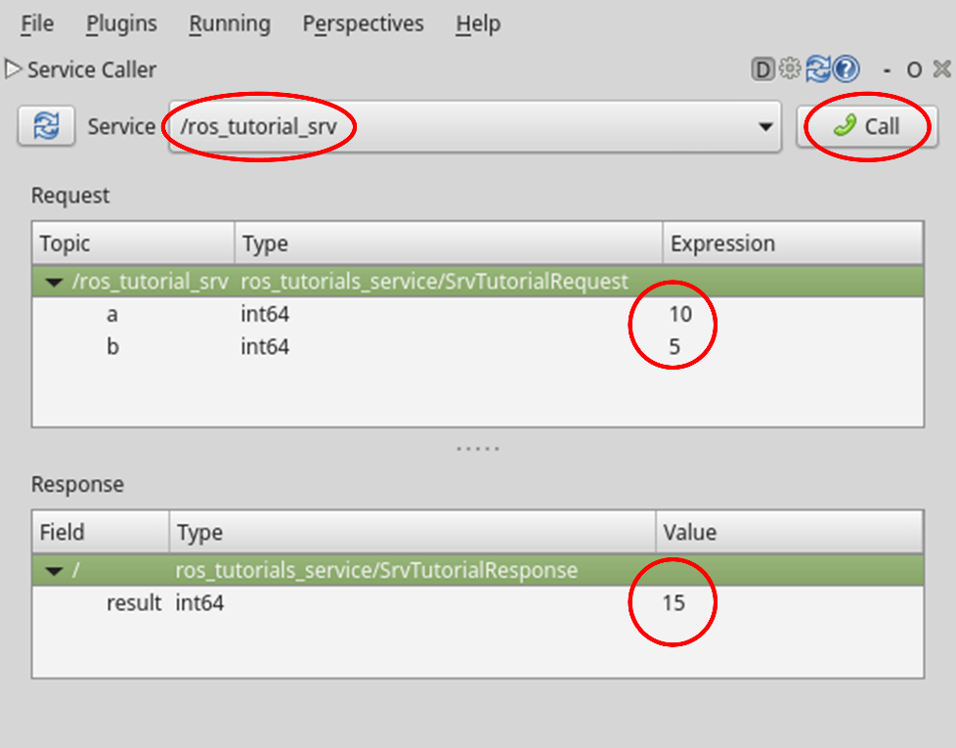
Service / Service server / Service client
[参考] 如何使用GUI工具, Service Caller
运行ROS GUI 工具 rqt.
在rqt编程菜单选择[Plugins] → [Service] → [Service Caller]. 如下图所示。
(1)在服务中输入/ ros_tutorial_srv
(2)输入 a = 10, b = 5
(3) 点击Call 按键.
(4)在结果中显示值为15。
$ rqt

Slide 49
此外!!!
一个节点可以充当多个发布者，订阅者，服务服务器和服务客户端！
随意使用节点。
ros::NodeHandle nh;
ros::Publisher topic_publisher = nh.advertise<ros_tutorials::MsgTutorial>("ros_tutorial_msg", 100);
ros::Subscriber topic_subscriber = nh.subscribe("ros_tutorial_msg", 100, msgCallback);
ros::ServiceServer service_server = nh.advertiseService("ros_tutorial_srv", calculation);
ros::ServiceClient service_client = nh.serviceClient<ros_tutorials::SrvTutorial>("ros_tutorial_srv");

Slide 50
源代码
我们已经看到了如何通过创建服务服务器和客户端节点并运行它们来在节点之间通信服务。 相关资源可以在下面的GitHub地址找到。
https://github.com/ROBOTIS-GIT/ros_tutorials/tree/master/ros_tutorials_service
如果要立即尝试，可以使用以下命令在catkin_ws / src文件夹中克隆源代码并进行构建。 然后运行service_server和service_client节点
$ cd ~/catkin_ws/src
$ git clone https://github.com/ROBOTIS-GIT/ros_tutorials.git
$ cd ~/catkin_ws
$ catkin_make
$ rosrun ros_tutorials_service service_server
$ rosrun ros_tutorials_service service_client

Slide 51
Parameters

Slide 52
Parameters
1) 通过parameters创建节点
在本节中，我们将修改service_server.cpp以使用参数选择算术运算符，而不是仅添加作为服务请求输入的a和b。
让我们按以下顺序修改service_server.cpp源：
$ roscd ros_tutorials_service/src → Go to the src folder, which is the source code folder of the package
$ gedit service_server.cpp → Modify source file contents
#include "ros/ros.h" // ROS basic header file
#include "ros_tutorials_service/SrvTutorial.h" // SrvTutorial.h" // SrvTutorial Service file header (auto-generated after build)
#define PLUS 1 // Add
#define MINUS 2 // Subtract
#define MULTIPLICATION 3 // Multiply
#define DIVISION 4 // Divide
int g_operator = PLUS;

Slide 53
Parameters
// If there is a service request, do the following
// service request is req, service response is res
bool calculation(ros_tutorials_service::SrvTutorial::Request &req,
ros_tutorials_service::SrvTutorial::Response &res)
{
// The values of a and b received when the service is requested are changed according to the parameter value.
// Calculate and store in service response value switch(g_operator)
{
case PLUS:
res.result = req.a + req.b; break;
case MINUS:
res.result = req.a - req.b; break;
case MULTIPLICATION:
res.result = req.a * req.b; break;

Slide 54
Parameters
case DIVISION:
if(req.b == 0){
res.result = 0; break;
}
else{
res.result = req.a / req.b; break;
}
default:
res.result = req.a + req.b; break;
}
// Display the values of a and b used in the service request and the result value corresponding to the service response
ROS_INFO("request: x=%ld, y=%ld", (long int)req.a, (long int)req.b);
ROS_INFO("sending back response: [%ld]", (long int)res.result);
return true;
}

Slide 55
Parameters
int main(int argc, char **argv) // Node main function
{
ros::init(argc, argv, "service_server"); // Initialize the node name
ros::NodeHandle nh; // Declare a node handle to communicate with the ROS system
nh.setParam("calculation_method", PLUS); // Parameter Initialization
// service server declaration, using SrvTutorial service file from ros_tutorials_service package
// Create the service server service_server. The service name is "ros_tutorial_srv"
// Set up to execute a function called calculation when there is a service request.
ros::ServiceServer ros_tutorial_service_server = nh.advertiseService("ros_tutorial_srv", calculation);
ROS_INFO("ready srv server!");

Slide 56
Parameters
ros::Rate r(10); // 10 hz
while (1)
{
nh.getParam("calculation_method", g_operator); // Change the operator to the value received from the parameter
ros::spinOnce(); // Callback function processing routine
r.sleep(); // sleep processing for routine iteration
}
return 0;
}
注意有关参数的setParam和getParam的用法.
[参考]可作为参数类型
可以将参数设置为整数，浮点数，布尔值，字符串，字典，列表等.
例如，1是一个整数，1.0是一个浮点数，“ Internet of Things”是一个字符串，true是一个布尔值，[1,2,3]是一个整数列表，a：b，c：d是字典 。

Slide 57
Parameters
2) 编译和运行节点
3) 查看 parameter 列表
“ rosparam list”命令显示了ROS网络中当前使用的参数列表，其中/ calculation_method是我们使用的参数。
$ cd ~/catkin_ws && catkin_make
$ rosrun ros_tutorials_service service_server
[INFO] [1495767130.149512649]: ready srv server!
$ rosparam list
/calculation_method
/rosdistro
/rosversion
/run_id

Slide 58
Parameters
4) parameter 使用案例
根据以下命令设置参数，并在每次请求相同服务时观察服务过程的变化。
在ROS中，参数可以从节点外部更改节点的流量，设置和处理。 这是一个非常有用的功能，因此请熟悉它。
$ rosservice call /ros_tutorial_srv 10 5 → Input variables a and b of arithmetic operationresult: 15 → The addition arithmetic sum, which is the default arithmetic operation
$ rosparam set /calculation_method 2 → subtract
$ rosservice call /ros_tutorial_srv 10 5
result: 5
$ rosparam set /calculation_method 3 → multiply
$ rosservice call /ros_tutorial_srv 10 5
result: 50
$ rosparam set /calculation_method 4 → divide
$ rosservice call /ros_tutorial_srv 10 5
result: 2

Slide 59
源代码
我们已经讨论了如何修改现有服务服务器和使用参数。
为了将其与先前创建的服务源代码区分开，相关源已重命名为ros_tutorials_parameter包，可以在下面的github地址找到它。
https://github.com/ROBOTIS-GIT/ros_tutorials/tree/master/ros_tutorials_parameter
如果要立即尝试，可以使用以下命令在catkin_ws / src文件夹中克隆源代码并进行构建。 然后运行service_server和service_client节点。
$ cd ~/catkin_ws/src
$ git clone https://github.com/ROBOTIS-GIT/ros_tutorials.git
$ cd ~/catkin_ws
$ catkin_make
$ rosrun ros_tutorials_parameter service_server_with_parameter
$ rosrun ros_tutorials_parameter service_client_with_parameter 2 3

Slide 60
roslaunch

Slide 61
如何使用roslaunch
rosrun 是执行节点命令。
roslaunch 可以执行一个或多个定义过的节点。
此外，roslaunch命令允许您指定选项，例如更改程序包参数或节点名称，配置节点名称空间，设置ROS_ROOT和ROS_PACKAGE_PATH以及在运行节点时更改环境变量。
roslaunch 使用‘* .launch’ 建立可执行及诶单, ，它基于XML，并提供特定于标签的选项。
执行命令模板为"roslaunch [package name] [roslaunch file]".

Slide 62
如何使用roslaunch
1) 使用 roslaunch
重命名先前创建的topic_publisher和topic_subscriber节点，然后运行它们。 为了理解roslaunch，让我们通过运行两个公共节点和两个订户节点来设置两个单独的消息通信。
首先，让我们编写一个* .launch文件。 用于roslaunch的文件的文件名为* .launch，您需要在package文件夹中创建一个名为launch的文件夹，并将启动文件放入该文件夹中。 可以使用以下命令创建该文件夹，然后创建一个名为union.launch的新文件。
$ roscd ros_tutorials_topic
$ mkdir launch
$ cd launch
$ gedit union.launch

Slide 63
如何使用 roslaunch
<launch>
<node pkg="ros_tutorials_topic" type="topic_publisher" name="topic_publisher1"/>
<node pkg="ros_tutorials_topic" type="topic_subscriber" name="topic_subscriber1"/>
<node pkg="ros_tutorials_topic" type="topic_publisher" name="topic_publisher2"/>
<node pkg="ros_tutorials_topic" type="topic_subscriber" name="topic_subscriber2"/>
</launch>
<launch>标记描述了使用roslaunch命令运行节点所需的标记。 <node>标签描述了由roslaunch运行的节点。 选项包括pkg，类型和名称。
pkg 包的名称
type 实际执行的节点名称（节点名称）
name 设置执行上述类型对应的节点时要附加的名称（可执行名称），通常将其设置为与type相同的名称，但是您可以设置它以在需要时更改名称。

Slide 64
如何使用 roslaunch
创建roslaunch文件后，请按以下方式运行union.launch。
[参考]使用roslaunch时如何显示状态
当roslaunch命令运行多个节点时，正在运行的节点的输出（信息，错误等）不会显示在终端屏幕上，这使调试变得困难。 如果添加--screen选项，则该终端上运行的所有节点的输出将显示在终端屏幕上。
$ roslaunch ros_tutorials_topic union.launch --screen

Slide 65
如何使用 roslaunch
执行结果?
结果，topic_publisher节点被重命名为topic_publisher1和topic_publisher2，并且两个节点正在运行.
topic_subscriber节点也已重命名为topic_subscriber1和topic_subscriber2。
$ rosnode list
/topic_publisher1
/topic_publisher2
/topic_subscriber1
/topic_subscriber2
/rosout

Slide 66
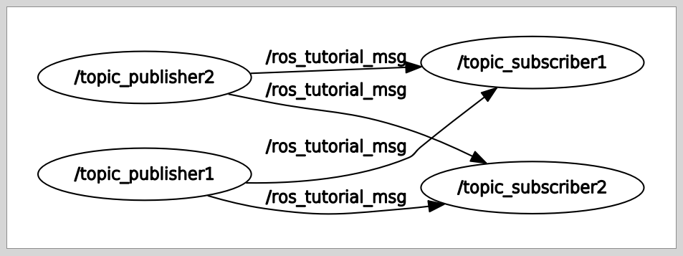
如何使用 roslaunch
问题是，与最初的意图不同"通过驱动两个发布者节点和订阅者节点来传递两个单独的消息," rqt_graph表示他们正在订阅对方的消息。
这是因为我们只是更改了要执行的节点的名称，而没有更改要使用的消息的名称。
让我们用另一个roslaunch名称空间标签解决此问题。

Slide 67
如何使用 roslaunch
让我们来修改 union.launch
$ roscd ros_tutorials_service/launch
$ gedit union.launch
<launch>
<group ns="ns1">
<node pkg="ros_tutorials_topic" type="topic_publisher" name="topic_publisher"/>
<node pkg="ros_tutorials_topic" type="topic_subscriber" name="topic_subscriber"/>
</group>
<group ns="ns2">
<node pkg="ros_tutorials_topic" type="topic_publisher" name="topic_publisher"/>
<node pkg="ros_tutorials_topic" type="topic_subscriber" name="topic_subscriber"/>
</group>
</launch>

Slide 68
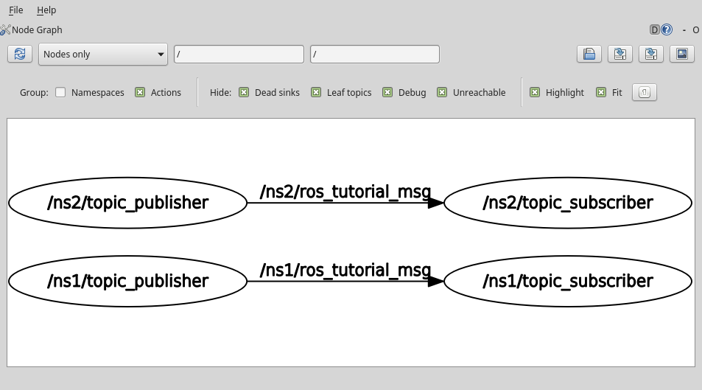
如何使用 roslaunch
更改后执行的节点的展示

Slide 69
如何使用 roslaunch
2) launch tag
<launch> 指向roslaunch语法的开头和结尾.
<node> 这是节点执行的标签。 您可以更改程序包，节点名称和执行名称.
<machine> 您可以设置运行节点的PC的名称，地址，ros-root和ros-package-path.
<include> 您可以导入另一个软件包或属于同一软件包的另一个启动，并将其作为启动文件运行.
<remap> 您可以通过节点名称，主题名称等更改正在使用的ROS变量的名称.
<env> 设置环境变量，例如路径和IP。 （几乎从未使用过）
<param> 设置参数名称，类型，值等.
<rosparam> 使用rosparam命令检查和修改参数信息，例如加载，转储和删除。
<group> 设置参数名称，类型，值等
<test> 用于测试节点 与<node>相似，但具有可用于测试的选项。
<arg> 您可以在启动文件中定义一个变量，因此可以在运行时更改参数，如下所示：
<launch>
<arg name="update_ period" default="10" />
<param name="timing" value="$(arg update_ period)"/>
</launch>
roslaunch my_package my_package.launch update_ period:=30

Slide 70
例程资料
https://github.com/ROBOTIS-GIT/ros_tutorials
尽管可以直接从网上阅读或下载，但是如果您想立即尝试，可以使用以下命令复制和构建存储库：
$ cd ~/catkin_ws/src
$ git clone https://github.com/ROBOTIS-GIT/ros_tutorials.git
$ cd ~/catkin_ws
$ catkin_make

